Slide 1


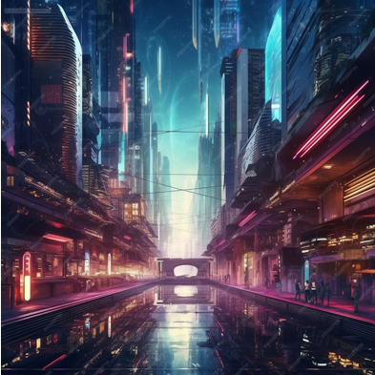
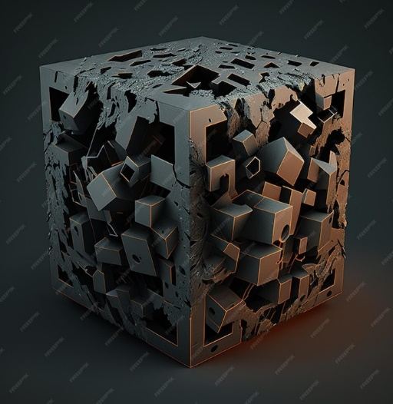
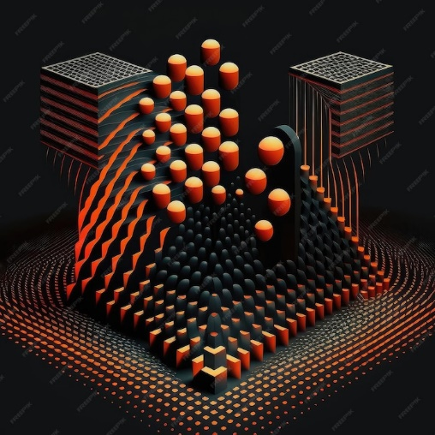
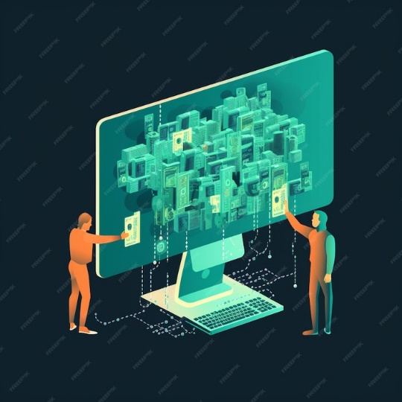
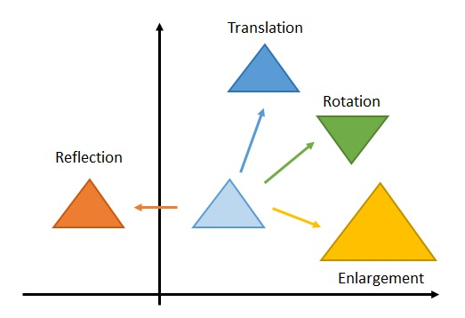

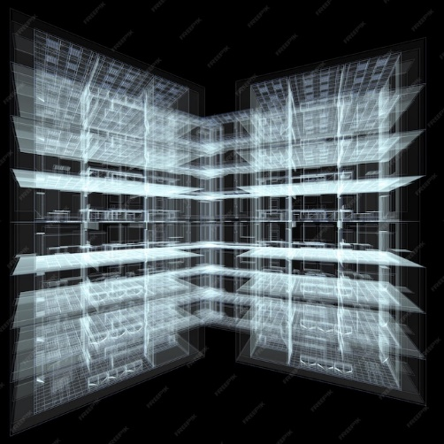
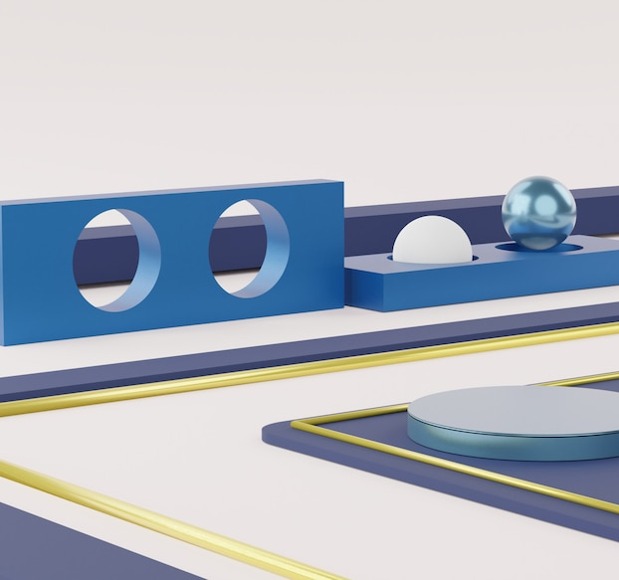
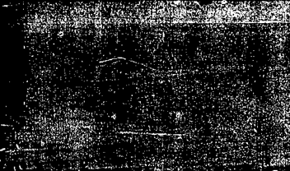
K. J. Somaiya College of Engineering, Mumbai – 400 077
(A Constituent College of Somaiya Vidyavihar University) Dept. of Science and Humanities
F.Y. B. Tech. Semester –II (2022-23)
Applied Mathematics-II
IA-II
Application of matrices in Computer Graphics
NAME : Om Thanage
ROLL NO. : 16010123217
DIV: 1 BATCH: C4
Introduction
Applications
The evolution of computer graphics has been driven by the use of matrices to achieve realistic visual effects. This presentation explores the transformative power of matrices in enhancing visual realism in computer graphics.
Texture Mapping
Matrices are key in creating lifelike lighting and shading effects in computer graphics, improving scene realism through manipulation.
Lighting and Shading
Matrices are vital for realistic lighting and shading in computer graphics, improving visual quality through manipulation.
Matrix Optimization Techniques
Efficient matrix use is vital for fast rendering in computer graphics. Optimization techniques like matrix multiplication and parallel processing maintain realism and performance.
Fundamentals of Matrices
Matrices help show transformations like translation, rotation, and scaling, making visuals more realistic.
Interactive apps
Matrices drive real-time visual manipulation in interactive applications, heightening user experiences with dynamic and realistic feedback.
Ray Tracing & Reflections
Matrices enable advanced effects like ray tracing and reflections, allowing for realistic lighting and visuals by manipulation.
Perspective & Projection
Matrices are crucial for accurately translating 3D scenes to 2D screens through perspective and projection transformations.

Slide 2
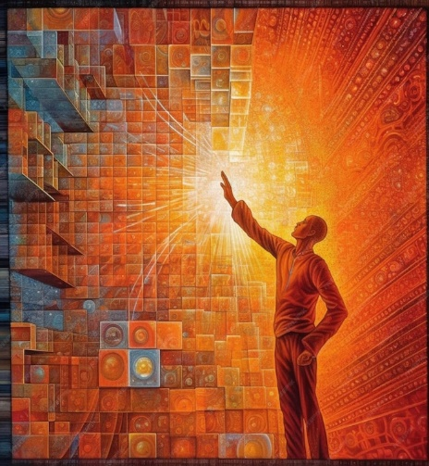
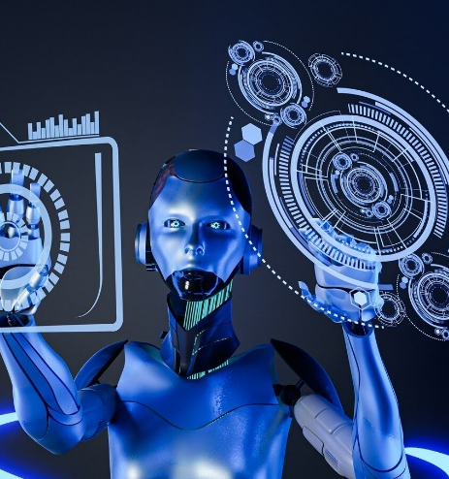


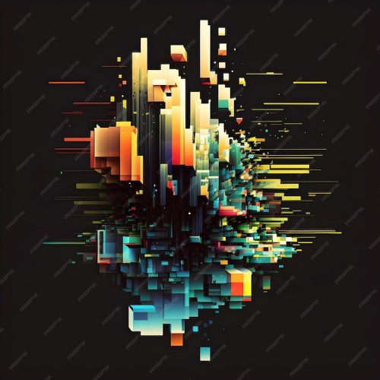


K. J. Somaiya College of Engineering, Mumbai – 400 077
(A Constituent College of Somaiya Vidyavihar University) Dept. of Science and Humanities
F.Y. B. Tech. Semester –II (2022-23)
Applied Mathematics-II
IA-II
Application of matrices in Computer Graphics
NAME : Om Thanage
ROLL NO. : 16010123217
DIV: 1 BATCH: C4
Challenges and Innovations
Artificial Intelligence and Matrices
The integration of artificial intelligence with matrices enhances visual realism by enabling intelligent rendering techniques. AI-driven matrix manipulation contributes to the generation of highly realistic computer graphics.
Addressing challenges such as computational complexity and memory management leads to continuous innovations in leveraging matrices for enhanced visual realism. Overcoming these challenges drives the evolution of computer graphics.
Case Studies
Exploring case studies of renowned graphics projects demonstrates the transformative impact of matrices on visual realism. Real-world examples showcase the power of matrices in creating compelling and lifelike computer-generated imagery.
Future Trends
Anticipating future trends in matrix-driven computer graphics offers insights into upcoming advancements. Innovations such as quantum computing and neural network integration are poised to revolutionize visual realism in computer graphics.
Conclusion
The transformative power of matrices in computer graphics is undeniable, shaping the future of visual realism. Embracing the potential of matrices leads to continuous advancements, driving the evolution of lifelike computer-generated imagery.
References
https://doi.org/10.31803/tg-20180119143651
(PDF) Matrix Applications in Computer Graphics (researchgate.net)
https://vitaminac.github.io/Matrices-in-Computer-Graphics/

